Slide 1

STANDARDS

Slide 2
What Is MISRA?
The Motor Industry Software Reliability Association (MISRA) refers to the widely adopted and legendary coding standard for C and C++ languages.
MISRA provides coding standards for developing safety-critical systems
Focuses on protecting applications against known safety violations and security vulnerabilities
MISRA first developed coding guidelines in 1998. These were specific to the C programming language. Since then, MISRA has added a coding standard for C++

Slide 3
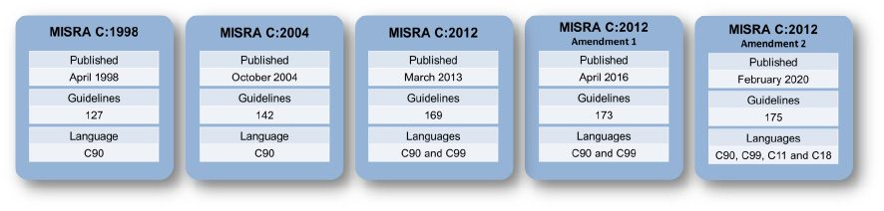
The Evolution of MISRA C
The first edition of MISRA C was published in 1998. MISRA has since published two more editions, MISRA C:2004 and MISRA C:2012, and two amendments to MISRA C:2012. With each publication, MISRA has added new guidelines and provided more direction on how to achieve MISRA C compliance.

Slide 4
Why Use MISRA Standards?
We have 122 mandatory and 20 advisory rules.
The MISRA C coding standard was originally written for the automotive embedded software industry.
But today, MISRA standards for C and C++ are widely used by embedded industries — including aerospace and defense, telecommunications, medical devices, and rail.

Slide 5
How to Achieve MISRA Compliance?
1. Know the Rules You need to know the MISRA coding rules pertinent to which version of C or C++ you’re using.
2. Check Your Code Constantly Continuously inspecting your code for violations is the best way to improve quality.
3. Set Baselines Embedded systems come with legacy codebases. By setting baselines, you can focus on making sure your new code is compliant.

Slide 6
How to Achieve MISRA Compliance?
4. Prioritize Violations Based on Risk You could have hundreds or even thousands of violations in your code. That’s why it’s important to prioritize rule violations based on risk severity. Some static code analysis tools can do this for you.
5. Document Your Deviations Sometimes there are exceptions to the rule. But when it comes to compliance, every rule deviation needs to be well-documented.
6. Monitor Your MISRA Compliance Keep an eye on how MISRA compliant your code is. Using a static code analyzer makes this easier by automatically generating a compliance report.

Slide 7
How to Achieve MISRA Compliance?
7. Choose the Right Static Code Analyzer Choosing the right static code analyzer makes everything else easy. It takes care of scanning your code — new and legacy — for violations. It prioritizes vulnerabilities based on risk.

Slide 8
The Misra rules
Environment
Language extensions
Documentation
Character sets
Identifiers
Types
Constants
Declarations and definitions
Initialization
Arithmetic type conversions
Pointer type conversions
Expressions

Slide 9
The Misra rules…
Control statement expressions
Control flow
Switch statements
Functions
Pointers and arrays
Structures and unions
Preprocessing directives
Standard libraries
Run-time failures

Slide 10
Environment rules
Environment
Rule 1.5 (advisory): Floating-point implementations should comply with a defined floating-point standard
Floating-point arithmetic has a range of problems associated with it. Some (but not all) of the problems can be overcome by using an implementation that conforms to a recognized standard.
An example of an appropriate standard is ANSI/IEEE Std 754
For example: /* IEEE 754 single-precision floating-point */
typedef float float32_t;

Slide 11
Language extensions
Language extensions
Rule 2.2 (required): Source code shall only use /* … */ style comments.
This excludes the use of // C99 style comments and C++ style comments, since these are not permitted in C90. Many compilers support the // style of comments as an extension to C90

Slide 12
Language extensions
Rule 2.3 (required):
The character sequence /* shall not be used within a comment.
C does not support the nesting of comments even though some compilers support this as a language extension.
A comment begins with /* and continues until the first */ is encountered. Any /* occurring inside a comment is a violation of this rule.
Consider the following code fragment: /* some comment, end comment marker accidentally omitted <> Perform_Critical_Safety_Function(X); /* this comment is not compliant */

Slide 13
The Misra rules…
Rule 2.4 (advisory):
Sections of code should not be “commented out”.
Where it is required for sections of source code not to be compiled then this should be achieved by use of conditional compilation (e.g. #if or #ifdef constructs with a comment).
Using start and end comment markers for this purpose is dangerous because C does not support nested comments, and any comments already existing in the section of code would change the effect.

Slide 14
Documentation
Documentation
Rule 3.4 (required): All uses of the #pragma directive shall be documented and explained.
The meaning of each pragma shall be documented. There shall be sufficient supporting description to demonstrate that the behavior of the pragma, and its implications for the application, have been fully understood.
Any use of pragmas should be minimized, localized and encapsulated within dedicated functions wherever possible.

Slide 15
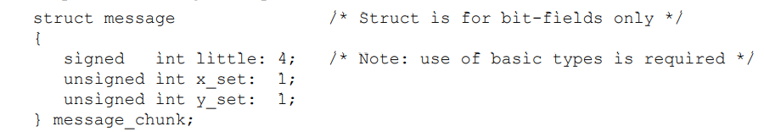
MISRA Rules…
Rule 3.5 (required):
If it is being relied upon, the implementation defined behavior and packing of bit fields shall be documented.
For example the following is acceptable:

Slide 16
Character sets
Character sets
Rule 4.1 (required):
Only those escape sequences that are defined in the ISO C standard shall be used.
Only “simple-escape-sequences” in ISO/IEC 9899:1990 and \0 are permitted escape sequences.
All “hexadecimal-escape-sequences” are prohibited.
The “octal-escape-sequences” other than \0 are also prohibited under Rule 7.1.

Slide 17
Character sets…
Rule 4.2 (required):
Trigraphs shall not be used.
Trigraphs are denoted by a sequence of 2 question marks followed by a specified third character (e.g. ??- represents a “~” (tilde) character and ??) represents a “]”).
They can cause accidental confusion with other uses of two question marks.
For example the string "(Date should be in the form ??-??-??)" would not behave as expected, actually being interpreted by the compiler as "(Date should be in the form ~~]"

Slide 18
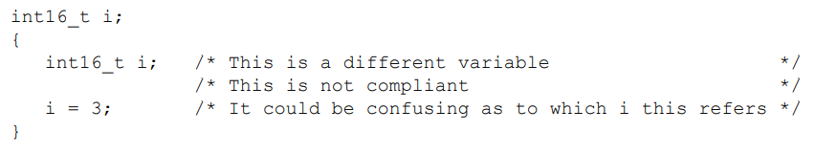
Identifiers
Identifiers
Rule 5.1 (required): Identifiers (internal and external) shall not rely on the significance of more than 31 characters.
Rule 5.2 (required): Identifiers in an inner scope shall not use the same name as an identifier in an outer scope, and therefore hide that identifier.

Slide 19
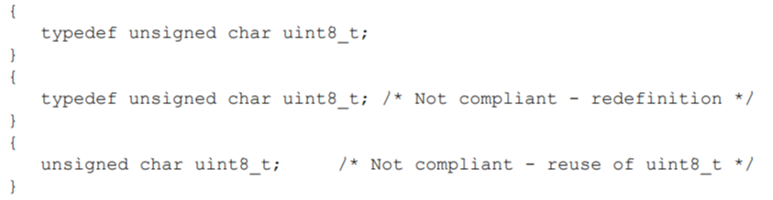
Identifiers…
Rule 5.3 (required):
A typedef name shall be a unique identifier. No typedef name shall be reused either as a typedef name or for any other purpose.
For example:

Slide 20
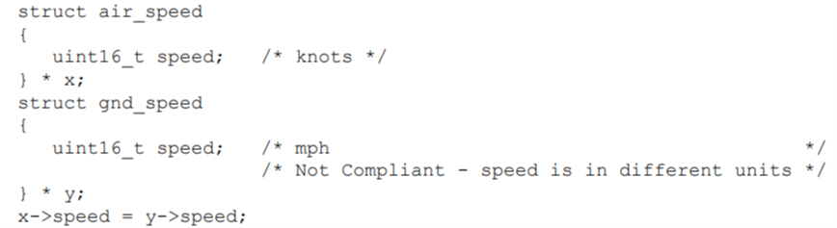
Identifiers…
Rule 5.7 (advisory):
No identifier name should be reused. Regardless of scope, no identifier should be re-used across any files in the system.

Slide 21
Types Rules
Types
Rule 6.1 (required): The plain char type shall be used only for the storage and use of character values.
Rule 6.2 (required): signed and unsigned char type shall be used only for the storage and use of numeric values.
There are three distinct char types, (plain) char, signed char and unsigned char. signed char and unsigned char shall be used for numeric data and plain char shall be used for character data.

Slide 22
Types Rules…
Rule 6.4 (required): Bit fields shall only be defined to be of type unsigned int or signed int.
Using int is implementation defined because bit fields of type int can be either signed or unsigned. The use of enum, short or char types for bit fields is not allowed because the behaviour is undefined.
Rule 6.5 (required): Bit fields of signed type shall be at least 2 bits long.
A signed bit field of 1 bit length is not useful.

Slide 23
Constants Rules
Constants
Rule 7.1 (required):
Octal constants (other than zero) and octal escape sequences shall not be used.

Slide 24
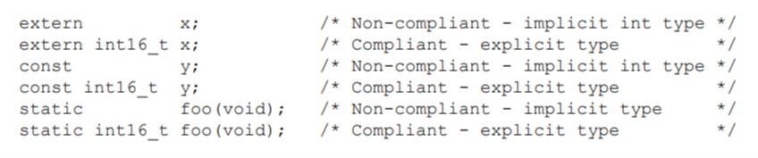
Declarations and definitions Rules
Declarations and definitions
Rule 8.1 (required): Functions shall have prototype declarations and the prototype shall be visible at both the function definition and call.
Rule 8.2 (required): Whenever an object or function is declared or defined, its type shall be explicitly stated

Slide 25
Declarations and definitions Rules…
Rule 8.3 (required): For each function parameter the type given in the declaration and definition shall be identical, and the return types shall also be identical.
For example:
Int funct_name(int x, float y); // prototype
Definition :
Int funct_name(int x, float y)
{
Int a = x;
Return a;
}

Slide 26
Rule 8.6 (required): Functions shall be declared at file scope. Declaring functions at block scope may be confusing, and can lead to undefined behaviour.
Example:
Static function declaration ;
Extern function declaration
Rule 8.7 (required): Objects shall be defined at block scope if they are only accessed from within a single function.

Slide 27
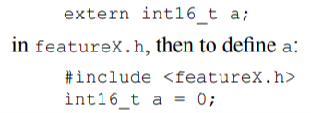
Declarations and definitions Rules…
Rule 8.8 (required): An external object or function shall be declared in one and only one file.
Normally this will mean declaring an external identifier in a header file, that will be included in any file where the identifier is defined or used.
For example:

Slide 28

Declarations and definitions Rules…
Rule 8.11 (required): The static storage class specifier shall be used in definitions and declarations of objects and functions that have internal linkage.
Rule 8.12 (required): When an array is declared with external linkage, its size shall be stated explicitly or defined implicitly by initialisation.

Slide 29
Initialization Rules
Initialization
Rule 9.1 (required): All automatic variables shall have been assigned a value before being used.
Rule 9.2 (required): Braces shall be used to indicate and match the structure in the non-zero initialisation of arrays and structures.
int16_t y[3][2] = { 1, 2, 3, 4, 5, 6 }; /* not compliant */
int16_t y[3][2] = { { 1, 2 }, { 3, 4 }, { 5, 6 } }; /* compliant */

Slide 30
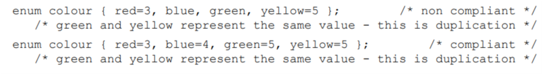
Initialization Rules…
Rule 9.3 (required): In an enumerator list, the “=” construct shall not be used to explicitly initialise members other than the first, unless all items are explicitly initialised.

Slide 31
Arithmetic type conversions Rules
Arithmetic type conversions
Implicit type conversions:
Implicit Type Conversion is also known as 'automatic type conversion'
These two rules broadly encapsulate the following principles:
• No implicit conversions between signed and unsigned types
• No implicit conversions between integer and floating types
• No implicit conversions from wider to narrower types
• No implicit conversions of function arguments
• No implicit conversions of function return expressions
• No implicit conversions of complex expressions

Slide 32
Arithmetic type conversions Rules…
extern void foo1(uint8_t x);
int16_t t1(void) { ...
foo1(u8a); /* compliant */
foo1(u8a + u8b); /* compliant */
foo1(s8a); /* not compliant */
foo1(u16a); /* not compliant *
}
int16_t foo2(void) {
f64a = f32a + f32b;
...
return s16a; /* compliant */
...
return s8a; /* not compliant */

Slide 33
Arithmetic type conversions Rules…
Arithmetic type conversions
Explicit conversions (casts):
Rule 10.3 (required): The value of a complex expression of integer type shall only be cast to a type of the same signedness that is no wider than the underlying type of the expression.
Rule 10.4 (required): The value of a complex expression of floating type shall only be cast to a floating type that is narrower or of the same size.

Slide 34
Arithmetic type conversions Rules…
Rule 10.5 (required): If the bitwise operators ~ and << are applied to an operand of underlying type unsigned char or unsigned short, the result shall be immediately cast to the underlying type of the operand.
When these operators (~ and <<) are applied to small integer types (unsigned char or unsigned short), the operations are preceded by integral promotion, and the result may contain high order bits which have not been anticipated.

Slide 35
Arithmetic type conversions Rules…
For example:
uint8_t port = 0x5aU;
uint8_t result_8;
uint16_t result_16;
uint16_t mode;
result_8 = (~port) >> 4; /* not compliant */
~port is 0xffa5 on a 16-bit machine but 0xffffffa5 on a 32-bit machine. In either case, the value of result is 0xfa, but 0x0a may have been expected. This danger is avoided by inclusion of the cast as shown below:
result_8 = ((uint8_t)(~port)) >> 4 ; /* compliant */
result_16 = ((uint16_t)(~(uint16_t)port)) >> 4 ; /* compliant */

Slide 36
Arithmetic type conversions Rules…
Rule 10.6 (required):
A “U” suffix shall be applied to all constants of unsigned type.
Any value with a “U” suffix is of unsigned type.
For example :
uint8_t port = 0x5aU;

Slide 37
Pointer type conversions Rules
Pointer type conversions
Pointer types can be classified as follows:
• Pointer to object
• Pointer to function
• Pointer to void
• The null pointer constant (the value 0 cast to type void *)

Slide 38
Pointer type conversions Rules…
Pointer type conversions
Rule 11.1 (required): Conversions shall not be performed between a pointer to a function and any type other than an integral type.
Conversion of a function pointer to a different type of pointer results in undefined behaviour.

Slide 39
Pointer type conversions Rules…
Rule 11.2 (required): Conversions shall not be performed between a pointer to object and any type other than an integral type, another pointer to object type or a pointer to void.
Such conversions are undefined. This rule means that an object pointer can be converted to or from:
An integral type;
Another pointer to object type;
A pointer to void.
No other conversions involving object pointers are permitted.

Slide 40
Pointer type conversions Rules…
Rule 11.3 (advisory):
A cast should not be performed between a pointer type and an integral type.
Casting between a pointer and an integer type should be avoided where possible, but may be unavoidable when addressing memory mapped registers or other hardware specific features.

Slide 41
Pointer type conversions Rules…
Rule 11.4 (advisory):
A cast should not be performed between a pointer to object type and a different pointer to object type.
Conversions of this type may be invalid if the new pointer type requires a stricter alignment.
uint8_t * p1;
uint32_t * p2;
p2 = (uint32_t *)p1; /* Incompatible alignment ? */

Slide 42
Pointer type conversions Rules…
Rule 11.5 (required):
A cast shall not be performed that removes any const or volatile qualification from the type addressed by a pointer.
uint16_t x;
uint16_t * const cpi = &x; /* const pointer */
const uint16_t * pci; /* pointer to const */
volatile uint16_t * pvi; /* pointer to volatile */
uint16_t * pi;
pi = cpi; /* Compliant - no conversion no cast required */
pi = (uint16_t *)pci; /* Not compliant */
pi = (uint16_t *)pvi; /* Not compliant */

Slide 43
Expressions Rules
Expressions
Rule 12.3 (required): The sizeof operator shall not be used on expressions that contain side effects.
int32_t i;
int32_t j;
j = sizeof(i = 1234); /* j is set to the sizeof the type of i which is an int */ /* i is not set to 1234.
Rule 12.7 (required): Bitwise operators shall not be applied to operands whose underlying type is signed.
Rule 12.10 (required): The comma operator shall not be used. ,

Slide 44
Expressions Rules…
Rule 12.11 (advisory):
Evaluation of constant unsigned integer expressions should not lead to wrap-around.
Rule 12.12 (required):
The underlying bit representations of floating-point values shall not be used.

Slide 45
Expressions Rules…
Rule 12.13 (advisory):
The increment (++) and decrement (--) operators should not be mixed with other operators in an expression.
For example a statement such as the following is not compliant: u8a = ++u8b + u8c--; /* Not compliant */
The following sequence is clearer and therefore safer:
++u8b;
u8a = u8b + u8c;
u8c--;

Slide 46
Control statement expressions Rules
Control statement expressions
Rule 13.1 (required):
Assignment operators shall not be used in expressions that yield a Boolean value.
For example write:
x = y;
if ( x != 0 )
{
foo();
}

Slide 47
Control statement expressions Rules…
and not:
if ( ( x = y ) != 0 ) /* Boolean by context */
{
foo();
}
or even worse:
if ( x = y )
{
foo();
}

Slide 48
Control statement expressions Rules…
Rule 13.2 (advisory):
Tests of a value against zero should be made explicit, unless the operand is effectively Boolean.
For example,
if x is an integer, then:
if ( x != 0 ) /* Correct way of testing x is non-zero */
if ( y ) /* Not compliant, unless y is effectively Boolean data (e.g. a flag) */

Slide 49
Control statement expressions Rules…
Rule 13.4 (required): The controlling expression of a for statement shall not contain any objects of floating type.
The controlling expression may include a loop counter, whose value is tested to determine termination of the loop. Floating-point variables shall not be used for this purpose.
for (float counter = 0.0f; counter < 1.0f; counter += 0.001f) {
...
} /* Non complaint */
for (int counter = 0; counter < 1000; ++counter) {
...
} /* complaint */

Slide 50
Control statement expressions Rules…
Rule 13.5 (required): The three expressions of a for statement shall be concerned only with loop control.
Noncompliant Code Example
for( int i = 0 ; i++< 10 ; i += 1 ) { // Noncompliant, loop counter is updated in the condition
}
for( int i = 0 ; ; ) { // Noncompliant, initialized variable i is not used in the condition
}
for( int i = 0 , j = 0 ; i < 10 ; i += j) { // Noncompliant, j is modified in the body
j = i + 1;
}

Slide 51
Control statement expressions Rules…
Rule 13.6 (required): Numeric variables being used within a for loop for iteration counting shall not be modified in the body of the loop.
Noncompliant Code Example
for (int i = 0; i < 10; i++) {
...
i = i - 1; // Noncompliant
...
}
for (int i = 0; i < getMaximumNumber(); i++) {
}

Slide 52
Control statement expressions Rules…
Compliant Solution
for (int i = 0; i < 10; i++) {
...
}
int stopCondition = getMaximumNumber();
for (int i = 0; i < stopCondition; i++) {

Slide 53
Control flow Rules
Control flow
Rule 14.1 (required): There shall be no unreachable code or There shall be no dead code.
switch (event)
{
case E_wakeup:
do_wakeup();
//break; /* unconditional control transfer */
do_more(); /* Not compliant - unreachable code */
case E_wakeup1:
do_wakeup();
/* ... */
default:
/* ... */
break;
}
}

Slide 54
Control flow Rules…
Rule 14.4 (required): The goto statement shall not be used.
Rule 14.5 (required): The continue statement shall not be used.
Rule 14.6 (required): For any iteration statement there shall be at most one break statement used for loop termination.
These rules are in the interests of good structured programming. One break statement is allowed in a loop since this allows, for example, for dual outcome loops or for optimal coding.

Slide 55
Control flow Rules…
Rule 14.7 (required): A function shall have a single point of exit at the end of the function.
This is required by IEC 61508, under good programming style.
Rule 14.8 (required): The statement forming the body of a switch, while, do … while or
for statement shall be a compound statement.
The statement that forms the body of a switch statement or a while, do … while or for loop, shall be a compound statement (enclosed within braces), even if that compound statement contains a single statement.
If()
{
Stat;
}
Compliant Solution
for (int i = 0; i < 10; i++){
stst;
}

Slide 56
Control flow Rules…
For example:
for (i = 0; i < N_ELEMENTS; ++i)
{
buffer[i] = 0; /* Even a single statement must be in braces */
}
while ( new_data_available )
process_data (); /* Incorrectly not enclosed in braces */
service_watchdog (); /* Added later but, despite the appearance
(from the indent) it is actually not part of the body of the while statement, and is executed only after the loop has terminated */

Slide 57
Control flow Rules…
Rule 14.10 (required): All if … else if constructs shall be terminated with an else clause.
if ( x < 0 )
{
log_error(3);
x = 0;
}
else if ( y < 0 )
{
x = 3;
}
else /* this else clause is required, even if the */
{ /* programmer expects this will never be reached */
/* no change in value of x */
}

Slide 58
Switch statements Rules
Switch statements
Rule 15.2 (required): An unconditional break statement shall terminate every non-empty switch clause.
switch (event)
{
case E_wakeup:
do_wakeup();
//break; /* unconditional control transfer */
do_more(); /* Not compliant - unreachable code */
case E_wakeup1:
do_wakeup();
/* ... */
default:
/* ... */
break;
}
Rule 15.3 (required): The final clause of a switch statement shall be the default clause.

Slide 59
Switch statements Rules…
Rule 15.4 (required): A switch expression shall not represent a value that is effectively Boolean.
For example:
switch (x == 0) /* not compliant - effectively Boolean */
{
..
Rule 15.5 (required): Every switch statement shall have at least one case clause

Slide 60
Functions Rules
Functions
Rule 16.1 (required): Functions shall not be defined with a variable number of arguments.
Rule 16.2 (required): Functions shall not call themselves, either directly or indirectly.
Rule 16.3 (required): Identifiers shall be given for all of the parameters in a function prototype declaration.
Rule 16.4 (required): The identifiers used in the declaration and definition of a function shall be identical.
Rule 16.5 (required): Functions with no parameters shall be declared and defined with the parameter list void.
void myfunc ( void );

Slide 61
Functions Rules…
Rule 16.6 (required):
The number of arguments passed to a function shall match the number of parameters.
Funct(1,2.5);
Rule 16.8 (required): All exit paths from a function with non-void return type shall have an explicit return statement with an expression.
int myfunc ( void )
{
Return int
}

Slide 62
Pointers and arrays Rules
Pointers and arrays
Rule 17.1 (required): Pointer arithmetic shall only be applied to pointers that address an array or array element.
Rule 17.2 (required): Pointer subtraction shall only be applied to pointers that address elements of the same array.
Rule 17.3 (required): >, >=, <= shall not be applied to pointer types except where they point to the same array.

Slide 63
Pointers and arrays Rules
Pointers and arrays
Rule 17.5 (advisory):
The declaration of objects should contain no more than 2 levels of pointer indirection.
struct s {
int8_t * s1; /* compliant */
int8_t ** s2; /* compliant */
int8_t *** s3; /* not compliant */
};

Slide 64
Pointers and arrays Rules…
Rule 17.6 (required):
The address of an object with automatic storage shall not be assigned to another object that may persist after the first object has ceased to exist.
For example
int8_t * foobar(void)
{
int8_t local_auto;
return (&local_auto); /* not compliant */
}

Slide 65
Structures and unions Rules
Structures and unions
Rule 18.1 (required): All structure and union types shall be complete at the end of a translation unit.
struct tnode * pt; /* tnode is incomplete at this point */
struct tnode
{
int count;
struct tnode *left;
struct tnode * right;
}; /* type tnode is now complete */

Slide 66
Preprocessing directives Rules
Preprocessing directives
Rule 19.2 (advisory): Non-standard characters should not occur in header file names in #include directives.
Rule 19.3 (required): The #include directive shall be followed by either a <filename> or
"filename" sequence.
For example, the following are allowed.
#include "filename.h"
#include <filename.h>
#define FILE_A "filename.h"
#include FILE_A

Slide 67
Preprocessing directives Rules…
Rule 19.15 (required): Precautions shall be taken in order to prevent the contents of a header file being included twice.
For example a file called “ahdr.h” might be structured as follows:
#ifndef AHDR_H
#define AHDR_H
/* The following lines will be excluded by the
preprocessor if the file is included more
than once */
...
#endif

Slide 68
Standard libraries Rules
Standard libraries
Rule 20.1 (required): Reserved identifiers, macros and functions in the standard library, shall not be defined, redefined or undefined.
Rule 20.2 (required): The names of standard library macros, objects and functions shall not be reused.
Rule 20.4 (required): Dynamic heap memory allocation shall not be used.
Rule 20.9 (required): The input/output library shall not be used in production code

Slide 69
Run-time failures Rules
Run-time failures
Rule 21.1 (required): Minimisation of run-time failures shall be ensured by the use of at least one of (a) static analysis tools/techniques; (b) dynamic analysis tools/techniques; (c) explicit coding of checks to handle run-time faults.

Slide 70
Run-time failures…
arithmetic errors
This includes errors occurring in the evaluation of expressions, such as overflow, underflow, divide by zero or loss of significant bits through shifting. In considering integer overflow, note that unsigned integer calculations do not strictly overflow (producing undefined values), but the values wrap around (producing defined, but possibly wrong, values).

Slide 71
Run-time failures…
pointer arithmetic
Ensure that when an address is calculated dynamically the computed address is reasonable and points somewhere meaningful. In particular it should be ensured that if a pointer points within a structure or array, then when the pointer has been incremented or otherwise altered it still points to the same structure or array

Slide 72
Run-time failures…
array bound errors
Ensure that array indices are within the bounds of the array size before using them to index the array.
function parameters
Rule 20.3 (required): The validity of values passed to library functions shall be checked.

Slide 73
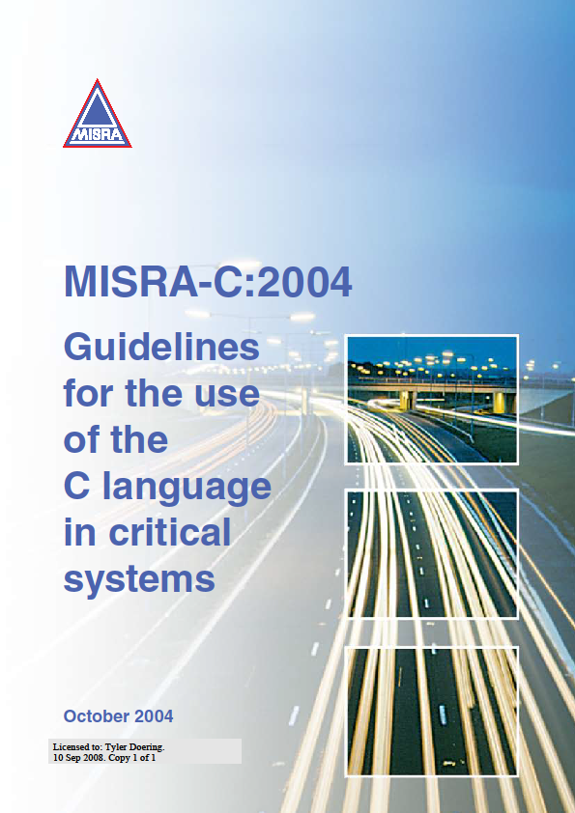
References
1. Coding Rules (rikkeisoft.github.io)
2. MISRA C 2004
Refer the attachment

Slide 74
Questions?

Slide 75
Thank You

